Slide 1
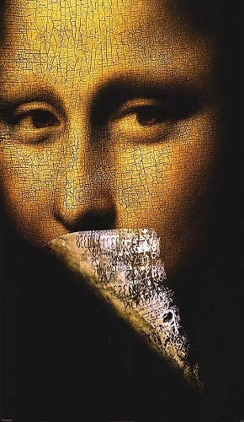


IIIT- A
EFFERVESCENCE
PRESENTS
STEGOL
I
CA
19
20
5
7
15
12
9
3
1
It is the art of covered or hidden
Writing .The purpose of steganography
is 'covert communication' to hide
a message from a third party.
Contact Us :
Anoop Arora 9358402810
Kunal Bansal 9559704522
1St Oct 2012
12:00 PM - 5:00 PM ONLINE

